Slide 1
Implementing SDMX within Morocco’s Statistical Data Base (BDS) BY Mr. Houssam EL OUINKHIR : Computer developer and DBA oracle
UNSD-DFID Project: Fourth Workshop on CountryData – Building better dissemination systems for national
development indicators
Phnom Penh, Cambodia, 21-25 April 2014

Slide 2
Content
Morocco's Statistical Data Base (BDS).
BDS modules.
Integrating SDMX into BDS.
Using SDMX for data exchange.

Slide 3
Morocco's Statistical Data Base
created in the early 80s.
Contains 40000 time series to track the evolution of the economic and socio-demographic situation in the country since 1970.
we reached the migration phase on the upgrading process to new BDS.

Slide 4
BDS modules
Our BDS contains 4 modules:
Indicators consulting.
BDS Administration
Generating publications.
SDMX and XML exporting

Slide 5
Integrating SDMX into BDS
We Use XML and XSLT for implementing SDMX within BDS.
SDMX file generation for a given indicators goes through several steps:
1: mapping between BDS codes and DSD code.
2 storing the mapping into an XML file.
3: exporting BDS data into data XML file.
4: An XSLT style sheet transform s our data into SDMX.

Slide 6
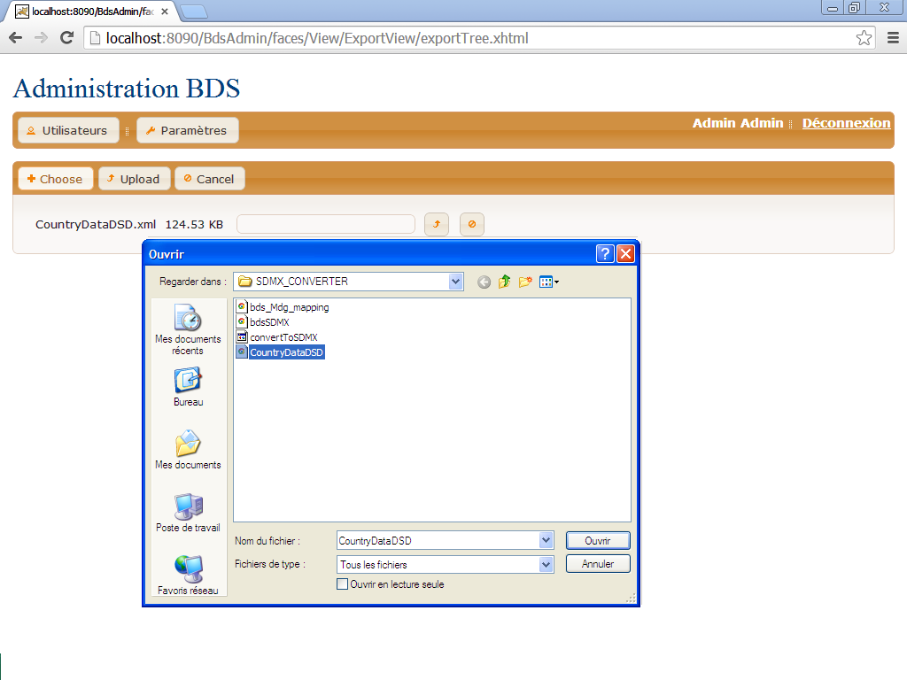
Integrating SDMX in BDS

Slide 7
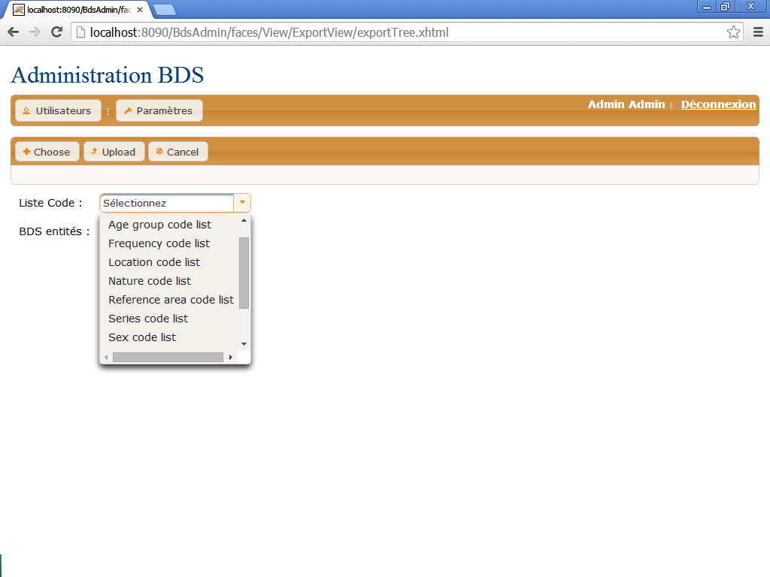
Integrating SDMX in BDS

Slide 8
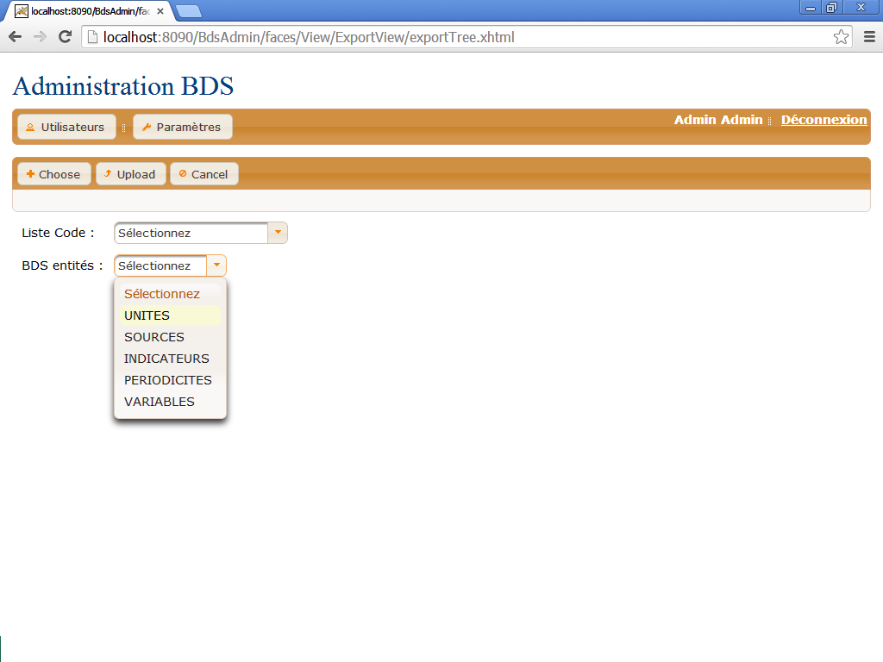
Integrating SDMX in BDS

Slide 9
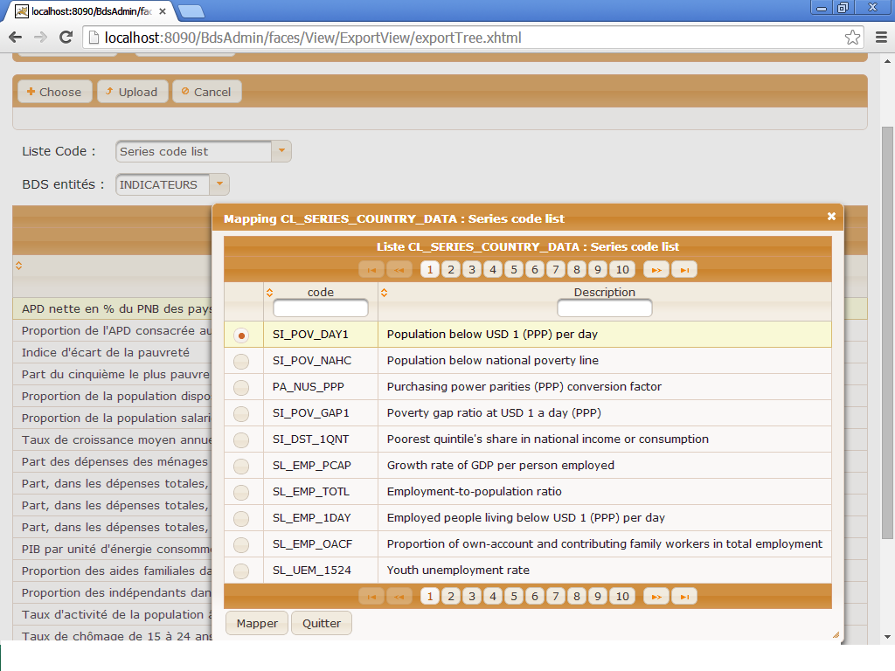
Integrating SDMX in BDS

Slide 10
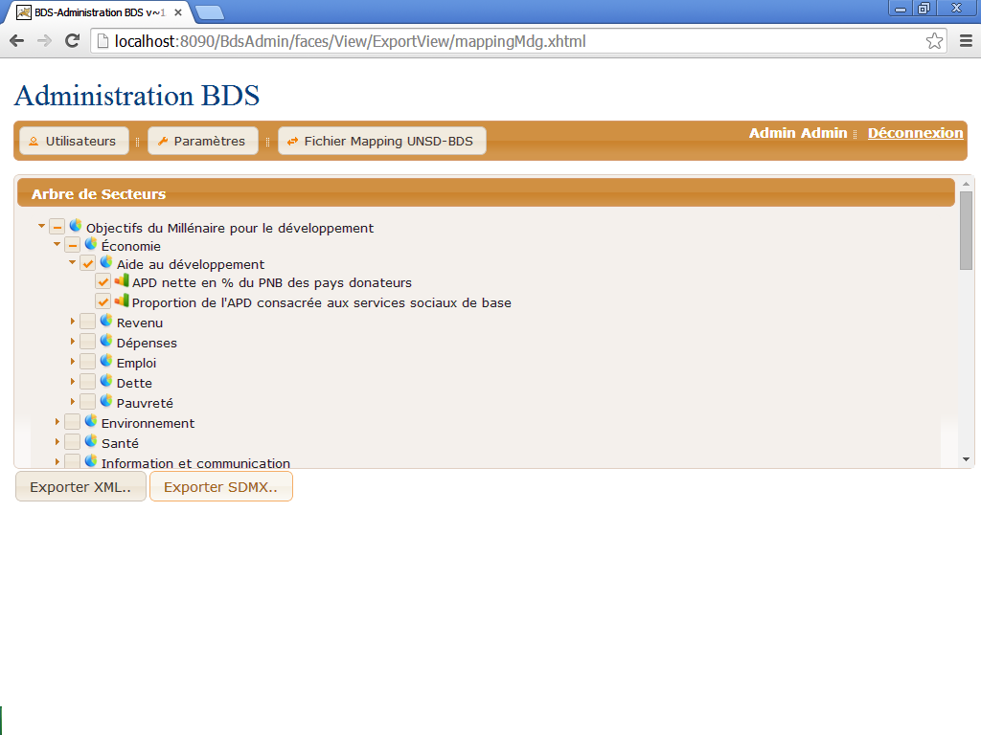
Integrating SDMX in BDS

Slide 11
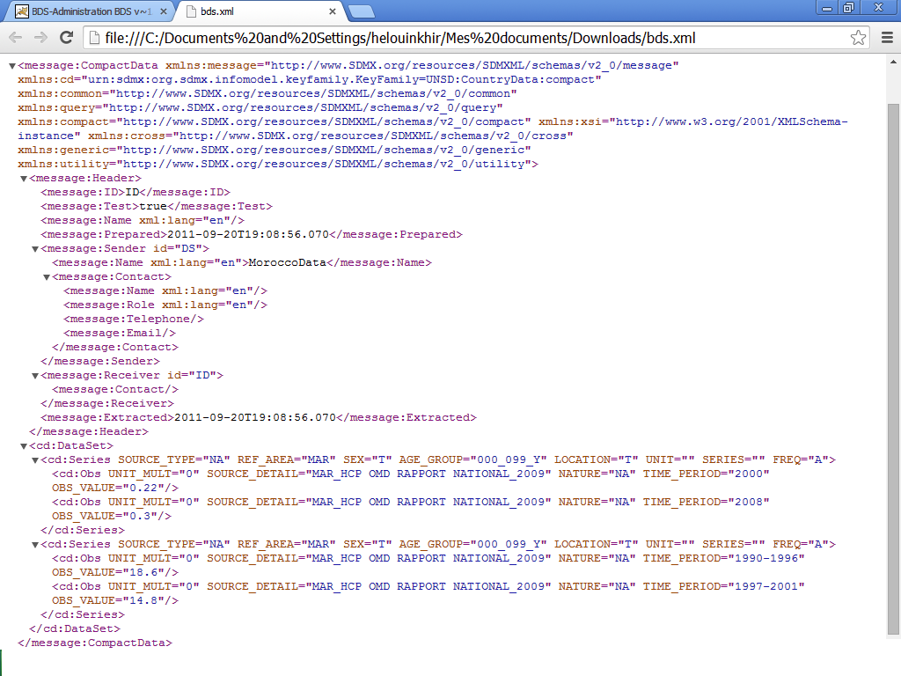
Integrating SDMX in BDS

Slide 12
Integrating SDMX in BDS
Fusion registry
Sends update notifications to subscribers
Enables automated data and metadata transfers.
Installed by UNSD last year.

Slide 13
Using SDMX for exchanging data with our partners
We plan to use SDMX for data exchange with national partners. Such as national accounts direction, employment division, lines ministres and others.
we will move to that stage after data migration.
We are planning to use Eurostat SDMX tools in this stage.

Slide 14
Thank you

